Slide 1

Microsoft AL
Importants and Excercises

Slide 2

Core Statements on the subject of Programming AL What the wise man says
Programming AL is almost like programming C/Side TXT files
Use MS Txt2AL Converter whenever you‘re helpless
What changes is the object structure: Fobs in Object Designer → AL (txt) Files in File System
It is crucial to setup a normalized file structure to
become more efficient
give „everyone“ the chance to „participate a development“ without the need of lengthy project individual introductions
It is lots more about getting familiar with guidelines and „doings“ than learning to code AL
if “actions are too cumbersome”, we will think about suitable tool-assistance

Slide 3
Programming in AL IF you don’t know what to do
If you don‘t know, what to do - 2: Use Txt2AL Converter
If you don‘t know, what to do - 1: Press „Ctrl+Space“
If you don‘t know, what to do - 3: Press „t<context>“

Slide 4
Literature / further Reading & Watching
VS Code
https://code.visualstudio.com/docs/getstarted/introvideos
https://jpearson.blog/2019/01/31/vs-code-powershell-git-5-things/
https://code.visualstudio.com/docs/getstarted/tips-and-tricks: multi cursor editing …
…

Slide 5
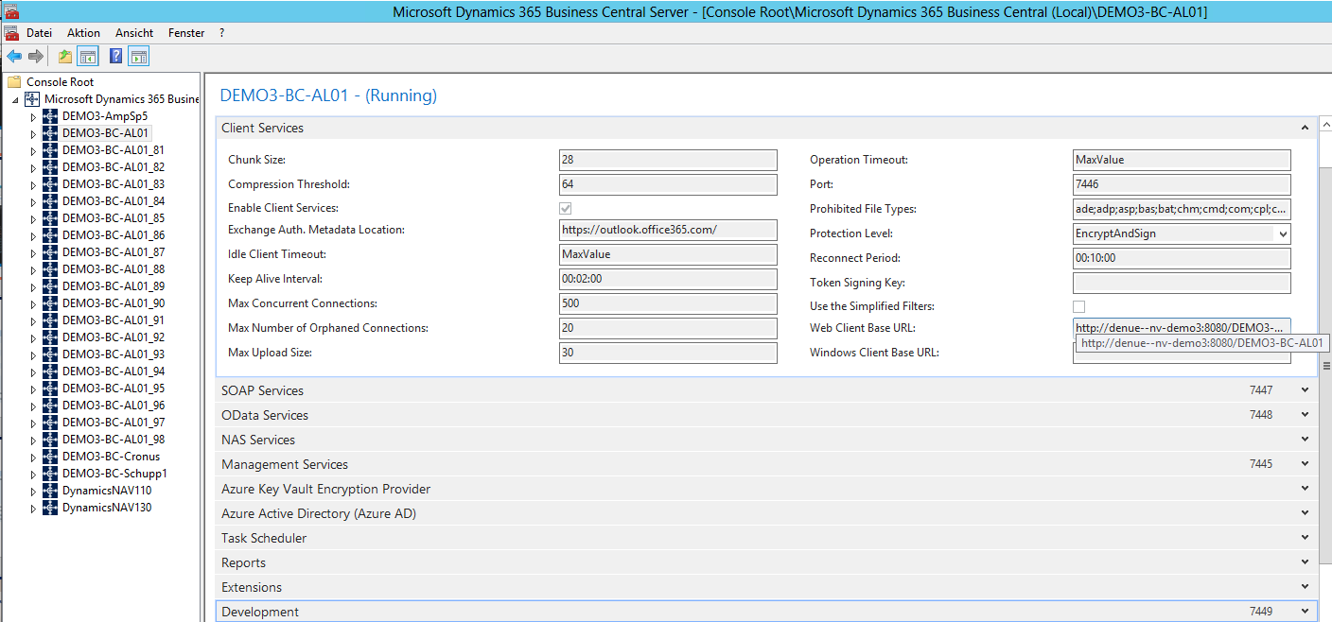
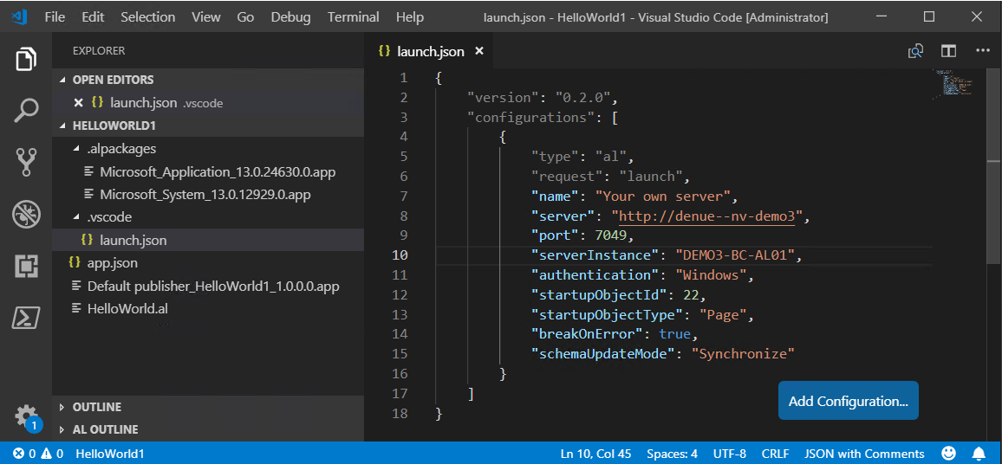
Boundary Conditions / Setups: HowTo handle a Project Specifying BC Target → launch.json
more detailed

Slide 6
APP Organization
- „Namespace / Prefixing“
- Philosophy
- Enveloping Folder Structure
- Naming Conventions „Agent Folders / Files“
- Examples
- Documentation: logs and tags
Hello World
our very first page extension?

Slide 7
Programming in AL APP Organization - Unique Namespace: Prefixing
Forced by the possibility of changing environment: suitable Prefixing to create uniqueness
(separated by a „Space“ from the object‘s name)
Use the Prefix CCO (Cosmo Consult Operations) for the following:
Objects
Name
Object Codeunits
Name
Object Extensions
Name
Global Procedures
Fields (Table)
Keys / KeyNames
Controls (Page)
Actions (Page)
Values (Enum)
Prefix „CCOT“ for Test Objects

Slide 8
Programming in AL APP Organization - Philosophy
Philosophy
Group together what belongs together
Forget about IDs as sort criterion
Create an understandable and easily enforceable rule on where code should be stored and how files should be named
„Agent Folder“ Table x
Table x
or
Extension of Table x
Object Codeunit of Table x
xliff ?
log of Table x
„Agent Folder“ Page y
Page y
or
Extension of Page y
Object Codeunit of Page y
xliff ?
log of Page y
„Agent Folder“ Report z
Report z
or
(Report Extension)
Object CU of Report z
Layout
xliff ?
log of Report z
„Agent Folder“ Codeunit u
Codeunit u
Object CU of Codeunit u
xliff ?
log of Codeunit u
„Agent Folder“ XML Port v
XML Port v
or
(?XML Port Extension?)
Object CU of XML Port v
xliff ?
log of XML Port v
„Agent Folder“ Query w
Query w
or
(?Query Extension?)
Object CU of Query w
xliff ?
log of Query w
„Agent Folder“ Enum q
Enum q
or
Enum Extension
xliff ?
log of Enum q
„Agent Folder“ Ctrl Add-In r
Control Add-In r
Object CU of Ctrl. Add-In r
xliff ?
log of Ctrl Add-In r

Slide 9
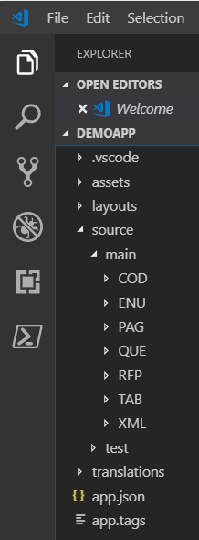
Programming in AL APP Organization - Enveloping Folder Structure
contains „launch.json“
contains assets like a logo …
contains report layouts to be published (c.f. below.)
organizes the actual program files, distinguishes …
„main“: distinguishes object types via subfolder structure <type>
<type> folders: contains agent object folders (location of program files, c.f. below)
„test“: contains test codeunits per GAP
contains translation file of the app, if existing (c.f. below.)
app.json file
app.tags (file): contains collection of „GAP“-tags representing al GAPs implemented so far, c.f. below

Slide 10
Programming in AL APP Organization - Naming Conventions Agent Folders / Files
Folder Names
<Type>
.
<Agent Object Name, abbreviated>
[.<Origin>]
File Names
<Type>
.
<Agent Object Name, abbreviated>
[.<Origin>]
[.<Subtype>]
.al
Object Names
CCO
[Agent Type]
<Agent Object Name>
[_+]
Log File
<Folder Name>
.log
(for docu-purposes, c.f. below)
Type
denotes the Object Type of the source Object
could be TAB, PAG, REP, COD, …
„abbreviated“
means without spaces …,
as suggested as Variable Name by the Object Designer
„Purchase Header → PurchaseHeader“
Origin
[„“,“cc“]; „“ if Object is app-external „cc“ if Object is app object
Subtype
[„“, „ext“, „code“]; „ext“ for extension objects; „code“ for Object Codeunits
„Agent Type“
Used for Object CUs only: indicates the type of the related object [T, P, R, X, C, …]
Appendix „+“
indicates in object names that the object extends a standard object.

Slide 11
Programming in AL APP Organization - Naming Conventions: Examples)
Object | Name of Object File | Name of Object | Object Folder
Tableextension Example 1: Item Example 2: Purchase Header | TAB.<Name of extended Tab, …>.ext.al TAB.Item.ext.al TAB.PurchaseHeader.ext.al | CCO_<Name of extended Tab>_+ "CCO Item +" "CCO Purchase Header +" | TAB.<Name Table, …> TAB.Item TAB.PurchaseHeader
Pageextension Example: Item Card | PAG.<Name of extended Page, …>.ext.al PAG.ItemCard.ext.al | CCO_<Name of extended Page>_+ "CCO Item Card +" | PAG.<Name of Page, …> PAG.ItemCard
Table (== new Table) Example: My App Table | TAB.<Name of new Table, …>.al TAB.MyAppTable.cc.al | CCO_<Name of new Table> "CCO My App Table" | TAB.<Name Table, …>.cc TAB.MyAppTable.cc
Page (== new Page) Example: My App Page | PAG.<Name of new Page, …>.al PAG.MyAppPage.cc.al | CCO_<Name of new Page> "CCO My App Page" | PAG.<Name of Page, …>.cc PAG.MyAppPage.cc
Report (== new Report) Example: My App Report | REP.<Name of new Report, …>.al REP.MyAppReport.cc.al | CCO_<Name of new Report> "CCO My App Report" | REP.<Name of Report, …>.cc REP.MyAppReport.cc
ObjectCU of APP-external Tabelle Example 1: Item Example 2: Purchase Header | TAB.<Name of Table, …>.code.al TAB.Item.code.al TAB.PurchaseHeader.code.al | CCO_T_<Name of Table>_+ "CCO T Item +" "CCO T Purchase Header +" | TAB.<Name of Table, …> TAB.Item TAB.PurchaseHeader
ObjectCU of APP-internal Tabelle Example: My App Table | TAB.<Name of new Table, …>.cc.code.al TAB.MyAppTable.cc.code.al | CCO_T_<Name of Table> "CCO T My App Table" | TAB.<Name of Table, …>.cc TAB.MyAppTable.cc
ObjectCU of APP-external Page Example: Item Card | PAG.<Name of Page>.code.al PAG.ItemCard.code.al | CCO_P_<Name of Page>_+ "CCO P Item Card +" | PAG.<Name of Page, …> PAG.ItemCard
ObjectCU of APP-internal Page Example: My App Page | PAG.<Name of Page>.code.al PAG.MyAppPage.cc.code.al | CCO_P_<Name of Page> "CCO P My App Page" | PAG.<Name of Page, …>.cc PAG.MyAppPage.cc
ObjectCU of APP-external Report Example: Order Confirmation | REP.<Name of Report>.code.al REP.OrderConfirmation.code.al | CCO_R_<Name of Report> "CCO R Order Confirmation +" | REP.<Name of Report, …> REP.OrderConfirmation
ObjectCU of APP-internal Report Example: My App Report | REP.<Name of Report>.code.al REP.MyAppReport.cc.code.al | CCO_R_<Name of Report> "CCO R My App Report +" | REP.<Name of Report, …>.cc PAG.MyAppReport.cc
… | … | … | …

Slide 12
Programming in AL APP Organization - Documentation: log-files and app-tags
Documentation via Log Files
One Log per Folder
Log file contains well known docu headers (per GAP)
<GAP-Tag>_<Date>_<Developer ID>: <Title of GAP>
Information on changes …
A „GAP-Tag“ consists of the GAP Identifier and a two digit suffix counting the generations of implementations of the gap.
If a GAP Implementation tsarts, the suffix is „.01“, if is reopened after a first completion, it gets suffix „.02“ and so on.
GAP-FI-001.01 01.01.2019 DENUE.MPRO: Default Description
Created
New field 55000 „Description 3“
Modified
…..
Remark: perhaps, we will be able to skip documentation in the future, using Azure DevOps …

Slide 13
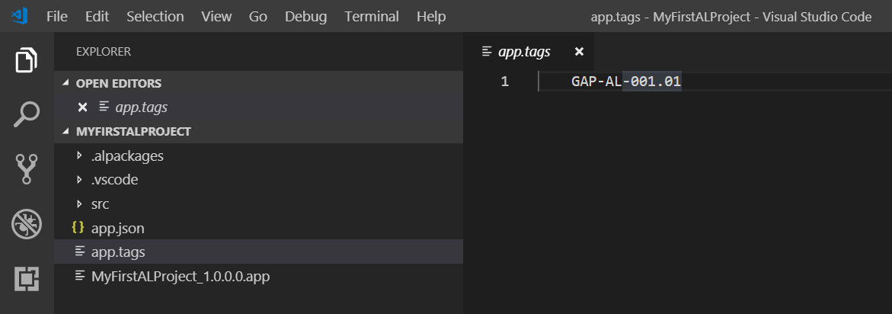
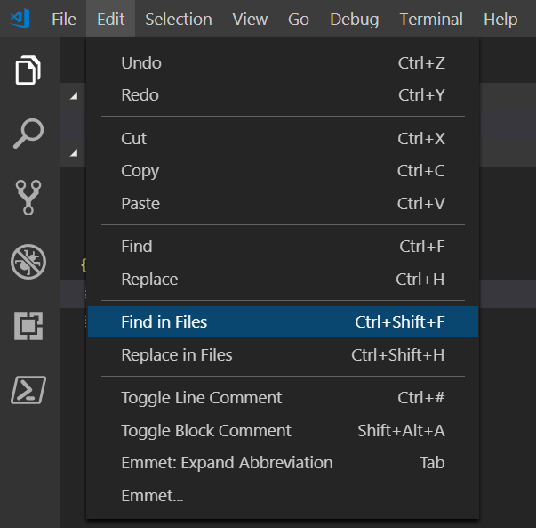
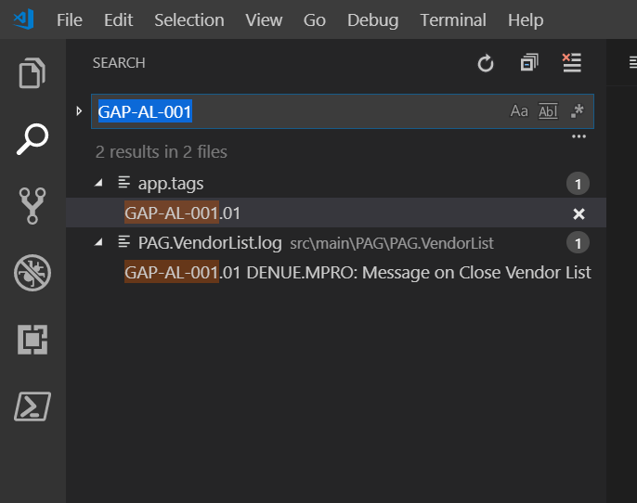
Programming in AL APP Organization - Documentation: log-files and app-tags
The „app.tags“ file
Loctaed in the root folder of the app
Contains al list of the GAPs implemented up to the current project state
[GAP-ID].[xx]: the „xx“ denotes the „development phase“ of the GAP
Enables „app-wide“ search for GAP Implementations

Slide 14

HandsOn
HandsOn – Exercise 1
Hello World
our very first page extension?

Slide 15
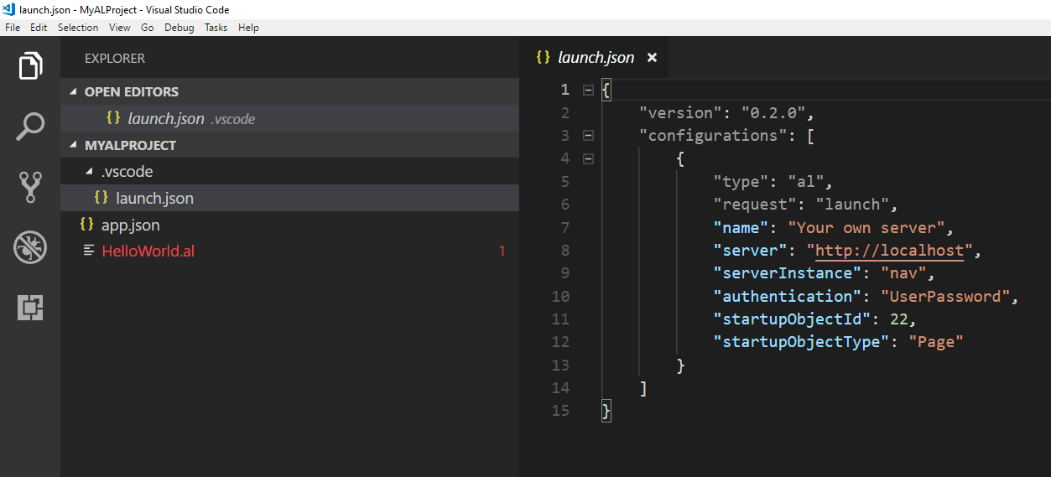
HandsOn – Exercise 1 | Hello World: our very first page extension
HandsOn
Understand the Example Extension „Hello World“
Configure your Environment / Run the Example
Load Template
Create „Hello World“
Open VS Code
Type F1 or Ctrl+Shift+P to open AL Command Line
Type a fragment of „AL: Go!“
Choose „AL: Go!“
Enter (AL) Project Path
Choose Environment (Cloud / OnPremise)
Oder: „Alt+A, Alt+L“
Configure Environment
Characterize your environment via proper values in the launch.json file
Define the APP
Characterize your APP via proper values in the app.json file
Introduce the Target DB‘s object structure to your APP
Download Symbols
Type F1 or Ctrl+Shift+P to open AL Command Line
Type a fragment of “Download Symbols”
Choose “Download Symbols”
If things don‘t work as expected:
Restart VS Code
(e.g., if you‘ve changed the „Web Client Base URL“
Compile / Publish /
Install / Launch
the APP
Hit „F5“ in VS Code ….

Slide 16
HandsOn
HandsOn – Exercise 2
Deinstalling the app (via Client)

Slide 17
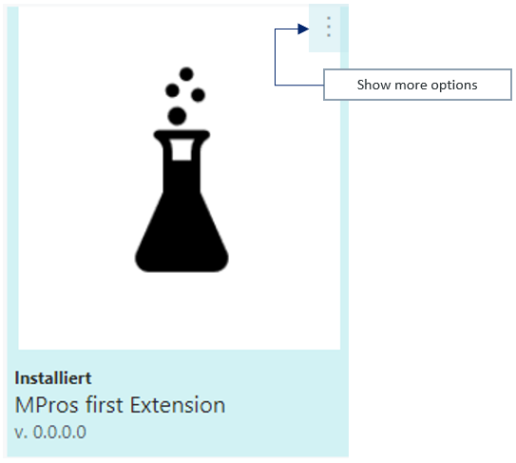
HandsOn – Exercise 2 | Deinstalling the app (via Client)
HandsOn
Open Client
Search „Extension Management“
Press “Show more options”
and choose “Uninstall”
Extension is now „Uninstalled“
but not „Unpublished“
Press “Show more options”
and choose “Unpublish”
Extension is now
„no longer available on the system“
Learn - Why this 2 step procedure?
To be able to have an extension available on dedicated tenants only
→ publish into a data base
→ Install into a tenant
!! data remains !!

Slide 18
HandsOn
HandsOn – Exercise 3
Configuring the Txt2AL Converter

Slide 19
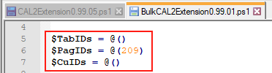
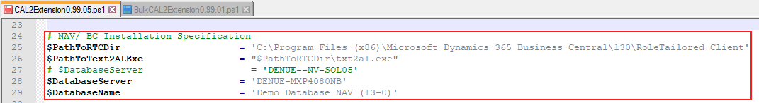
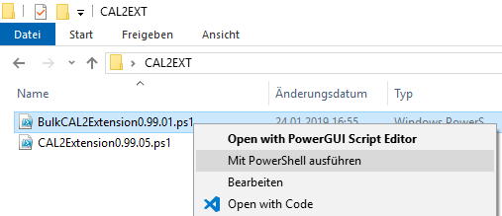
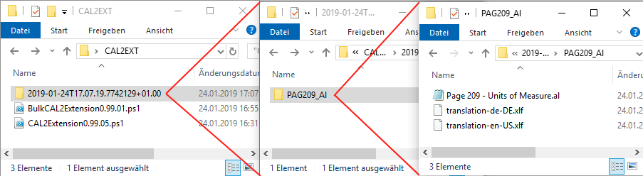


HandsOn
HandsOn – Exercise 3 | Configuring the Txt2AL Converter
Txt2AL Converter - HandsOn: Convert page „Units of Measure (209)“
Configure Converter
SQL-Server
Convert page „Units of Measure (209)“

Slide 20
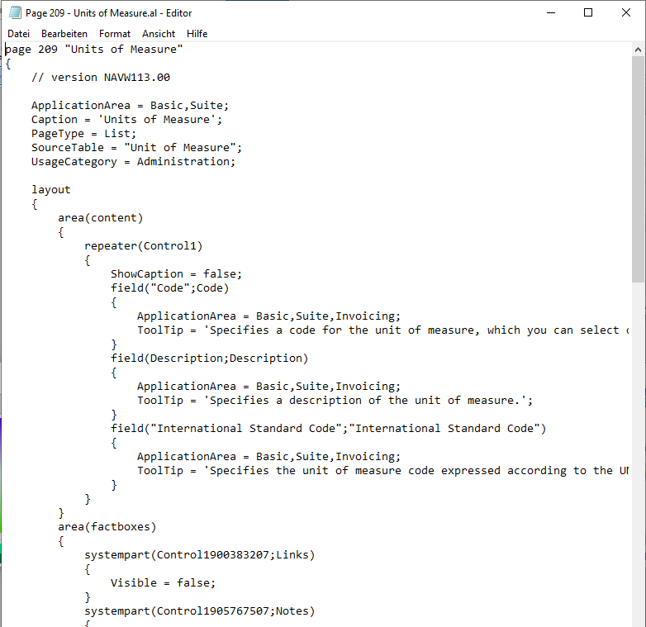
HandsOn
HandsOn – Exercise 3 Continued | Configuring the Txt2AL Converter
Result

Slide 21
HandsOn
HandsOn – Exercise 4
intelliSense

Slide 22
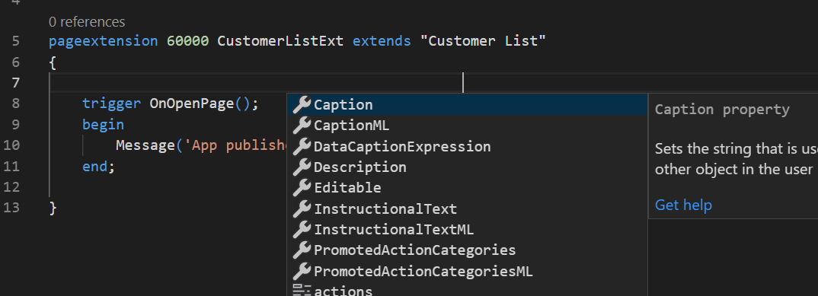
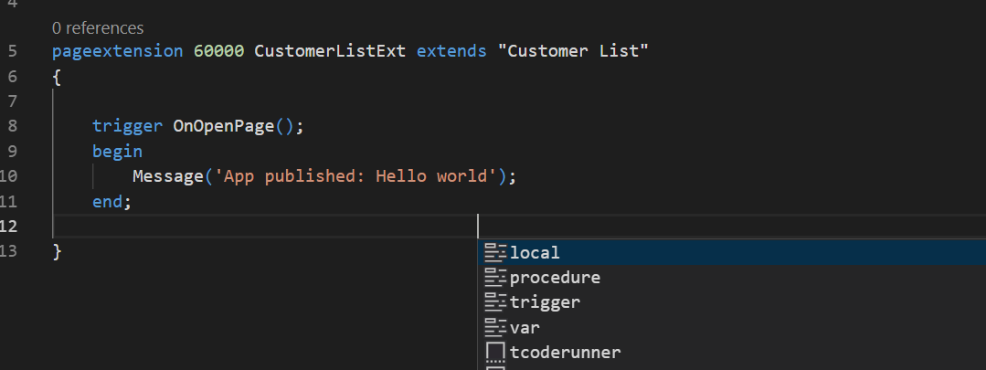
HandsOn – Exercise 4 | intelliSense
HandsOn
Open VS Code on „HelloWorld“ Project
Open file „HelloWorld.al“
Place the cursor above “trigger OnOpenPage()”
and press “Ctrl+Space” to activate Intellisense
Place the cursor below “trigger OnOpenPage()” block
and press “Ctrl+Space” again
Learn that
the suggestions depend on the actual context of your code – it’s “Intelli”
Elements of an object have to be placed in a certain order …. .

Slide 23
HandsOn
HandsOn – Exercise 5
AL Syntax: Caption ML

Slide 24
HandsOn – Exercise 5 | CaptionML
HandsOn
Open VS Code on „HelloWorld“ Project
Open Page Extension „HelloWorld.al“
Add CaptionML Property
Run Extension
Verify new page caption
Learn Syntax
CaptionML = ENU = 'List of Customers’,
DEU = 'Liste der Kunden';

Slide 25
HandsOn
HandsOn – Exercise 6
AL file structure

Slide 26
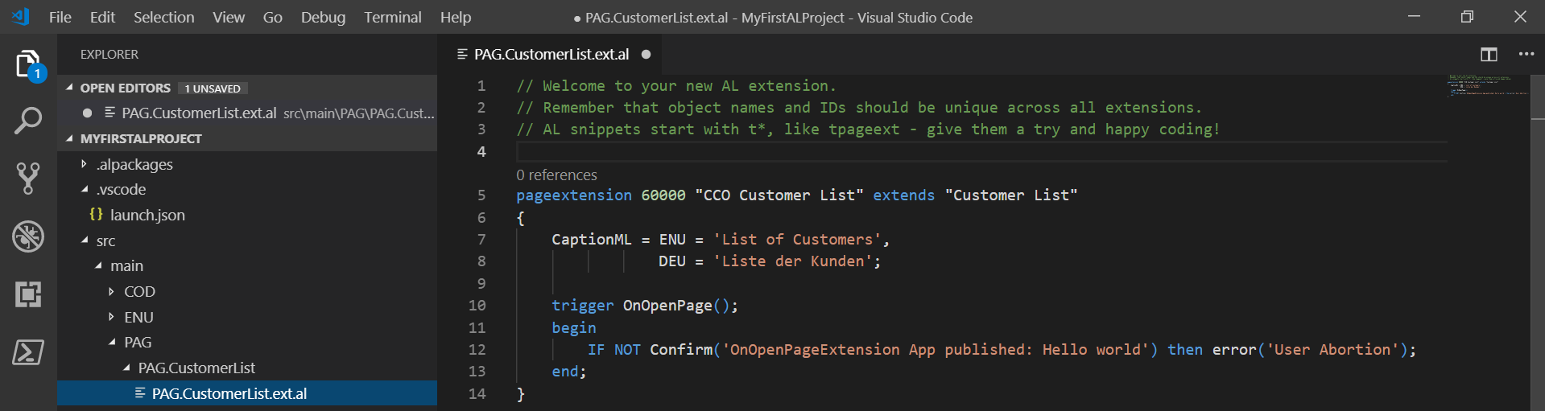
HandsOn
HandsOn – Exercise 6 | AL file structure
AL Project: Setting up the proper File / Folder structure
Clean up your project
Open „Hello World“ Project
Setup a proper file / folder Structure
Eventually rename your object files
Eventually rename your objects

Slide 27
HandsOn
HandsOn – Exercise 7
Codeunits and the Txt2AL Converter

Slide 28
HandsOn
HandsOn – Exercise 7 | Codeunits and the Txt2AL Converter
Excercise CU programming via Txt2AL converter: Message on open Vendor List
Open C/Side Dev Environment
Create Codeunit 55000 „CCO P Vendor List +“
Add some properties to the CU, e.g.
SingleInstance = Yes
Permissions on Vendor Tab
Add Event Subscriber „HandleOnOpenPage“
Add function „LaunchMessageVendorListIsOpen“
Call function from within subscriber
Implement the Object CU „classically“
Test Functionality
Convert to AL
Configure and use Txt2AL converter
Remove Codeunit from object designer
Eventually create the Project, setup app.json / launch.json
Setup proper file structure
Integrate the converted file
View file content
Integrate solution into „MyFirstALProject“
Run the Project
Eventually modify „launch.json“ to get vendor list launched immediately

Slide 29
HandsOn
HandsOn – Exercise 7.5
Extension Programming and the
Txt2AL Converter

Slide 30
HandsOn
HandsOn – Exercise 7.5 | Extension Programming and the Txt2AL Converter
Extension programming via Txt2AL converter – GAP-AL-000: „Description 3“ on „Item Card“
Open C/Side Dev Environment
Create backup of table „Item“ and page „Item Card“
Implement the Object CU „classically“
Add a field „Description 3“ to the Item Table
Add the new field on the „Item Card“ (where ever you want)
Implement a new action „Copy Description 3 from Description“
Implement the Object CU to hold relevant code
→ Don‘t forget naming conventions
Test Functionality
Convert to AL
Configure and use Txt2AL converter
Remove Modifications from object designer
Eventually create the Project, setup app.json / launch.json
Setup proper file structure
Integrate the converted file
View file content
Integrate solution into „MyFirstALProject“
Run the Project
Eventually modify „launch.json“ to get „Item Card“ launched immediately

Slide 31
HandsOn
HandsOn – Exercise 8
Procedures and Snippets

Slide 32
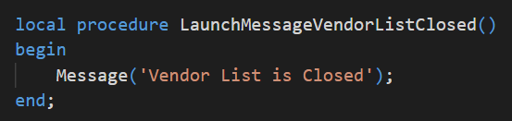
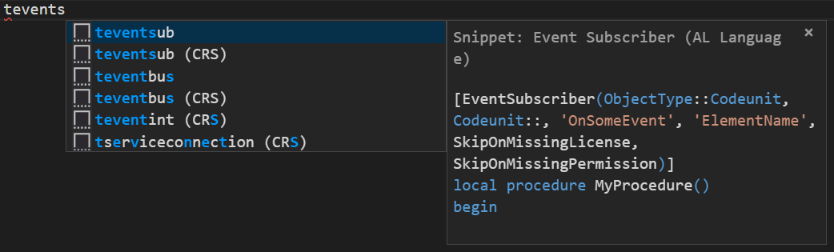
HandsOn
HandsOn – Exercise 8 | Procedures and Snippets
Implement „Message Vendor List is closed“ using Snippets
Open (My first) AL Project
Place cursor in new line (beyond existing Event Subscriber Procedure)
Find and Open Object CU of Vendor List
Type (leading) fragment of „teventsubscriber“ to start intelliSense
Implement new Functionality
Implement the Desired Function „LaunchMessageVendorListClosed“
Choose the right snippet and implement the Event Subscriber
Run and Test the Project

Slide 33
HandsOn
HandsOn – Exercise 9
Documentation: “logs and tags”

Slide 34
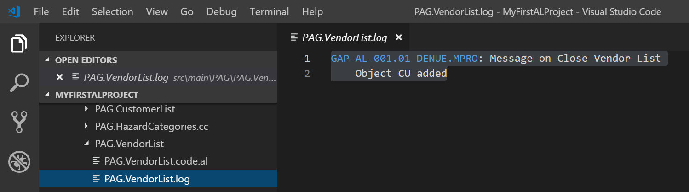
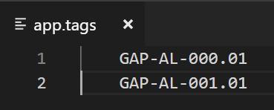
HandsOn
HandsOn – Exercise 9 | Documentation „logs and tags“
Finish „GAP-AL-000“: „Description 3 on Item Card“ and „GAP-AL-001: Message on Close Vendor List “
Open (My first) AL Project
Create Documentation (log-file(s))
Log your GAPs within the „app.tags“-file
Close open Editors and search for the GAP
Run and Test the Project

Slide 35
HandsOn
HandsOn – Exercise 9.5
Pages 1, Structure

Slide 36
HandsOn
HandsOn – Exercise 9.5 | Pages
Convert a Page of your choice from C/Side to AL and analyze the „Layout“

Slide 37
HandsOn
HandsOn – Exercise 10
Pages 2, moving Elements

Slide 38
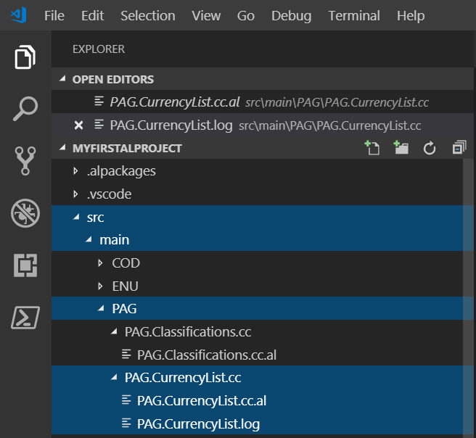
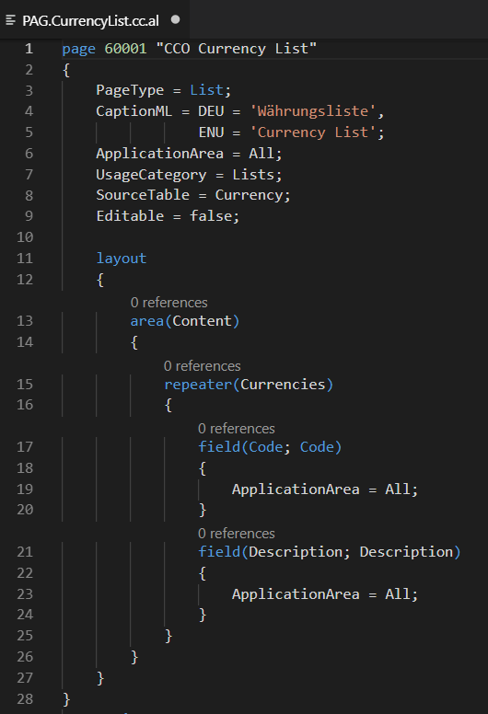
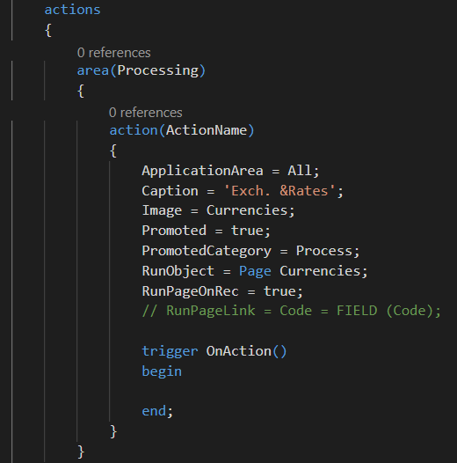
HandsOn
HandsOn – Exercise 10 | Pages
Implement „GAP-AL-002: Currency List“
Create a simple List Page „Currency List“, which shows a list of all Currencies and their Descriptions. It shall not be possible to edit the list. Via an Action „Show extended List“, it shall be possible to open the standard currency list „Currencies“.
Open (My first) AL Project
Create the file structure needed
Implement the page without the action
Verify functionality
Implement the desired action
Run and Test the Project

Slide 39
HandsOn
HandsOn – Exercise 10 | Pages
Implement „GAP-AL-002: Currency List“
Create a simple List Page „Currency List“, which shows a list of all Currencies and their Descriptions. It shall not be possible to edit the list. Via an Action „Show extended List“, it shall be possible to open the standard currency list „Currencies“.
Open (My first) AL Project
Create the file structure needed
Implement the page without the action
Verify functionality
Implement the desired action
Run and Test the Project

Slide 40
HandsOn
HandsOn – Exercise 10 | Pages
Implement „GAP-AL-002: Currency List“
Create a simple List Page „Currency List“, which shows a list of all Currencies and their Descriptions. It shall not be possible to edit the list. Via an Action „Show extended List“, it shall be possible to open the standard currency list „Currencies“.
Open (My first) AL Project
Create the file structure needed
Implement the page without the action
Verify functionality
Implement the desired action
Run and Test the Project

Slide 41
HandsOn
HandsOn – Exercise 10 | Pages
Implement „GAP-AL-002: Currency List“
Create a simple List Page „Currency List“, which shows a list of all Currencies and their Descriptions. It shall not be possible to edit the list. Via an Action „Show extended List“, it shall be possible to open the standard currency list „Currencies“.
Open (My first) AL Project
Create the file structure needed
Implement the page without the action
Verify functionality
Implement the desired action
Run and Test the Project

Slide 42
HandsOn
HandsOn – Exercise 11
Object / File Structure

Slide 43
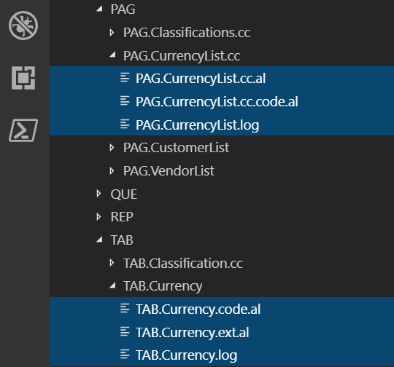
HandsOn
HandsOn – Exercise 11 | Object / File Structure
Implement „GAP-AL-003: Currency List advanced“
Extend the functionality of „GAP-AL-002 in a way that the user is prompted „Do you want to open the standard currency list“ when he hits the „Show extended List“ button.
Open (My first) AL Project
Page: OnAction Trigger
calls Object CU
Table Currency: LaunchExtendedList(HideDialog, …)
calls Object CU
Reimplement the Action
ObjectCU(Page): QueryLaunchExtendedList(…)
calls „Agent“
ObjectCU(Table) : LaunchExtendedList(HideDialog, …)
contains functionality
There might be other ways of carrying out this implementation
Run and Test the Project

Slide 44
HandsOn
HandsOn – Exercise 11.5
Table Relations and Txt2AL converter

Slide 45
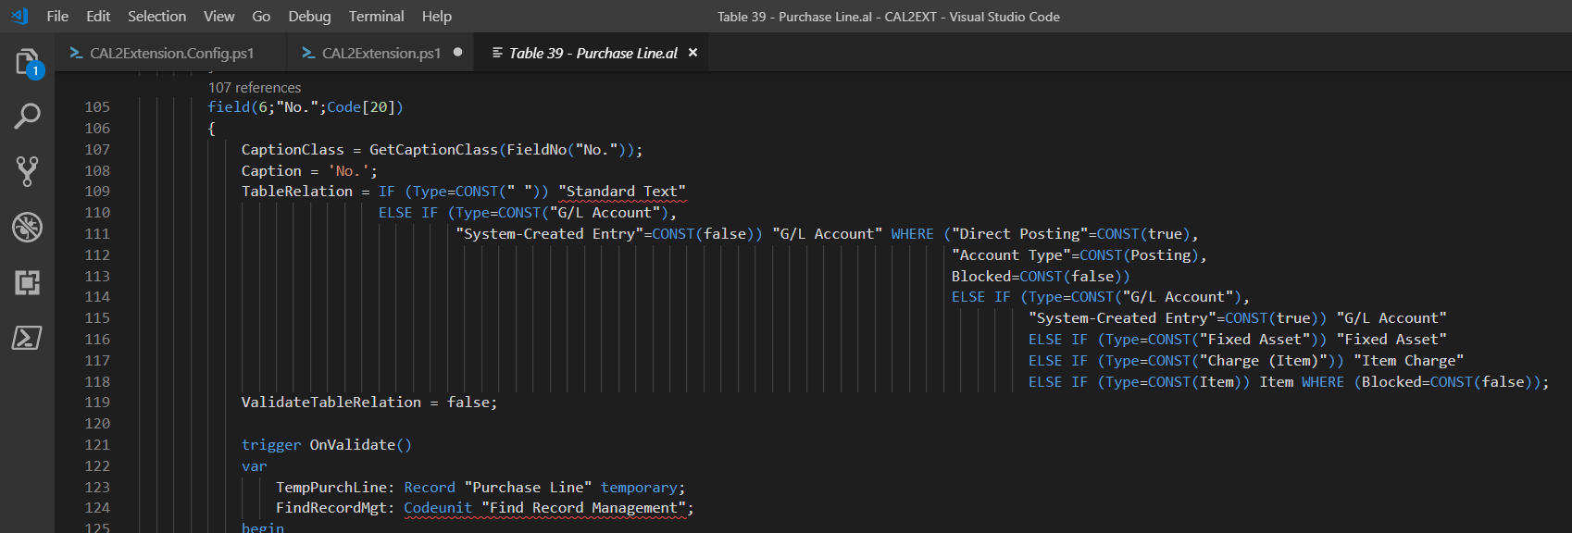
HandsOn
HandsOn – Exercise 11.5 | Table Relations and the Txt2AL converter
Gain insight into the syntax of Table Relations by „Txt2AL Converting“ table 39 „Purchase Line“
Configure Txt2AL COnverter
Convert Table 39 „Purchase Line“
Learn the syntax of „Table Relation Property“

Slide 46
HandsOn
HandsOn – Exercise 12
Module Hazard Category Part 1

Slide 47
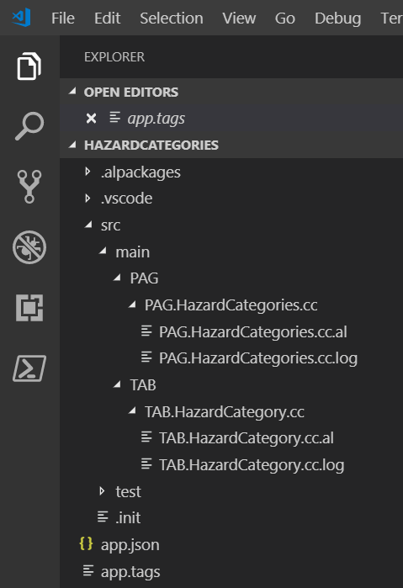
HandsOn
HandsOn – Exercise 12 | Module Hazard Category Part 1
FRD
It shall be possible to group Items according to their "Hazard Category". "Hazard Categories" should be freely definable. When an article is purchased via ordering, its "Hazard Category" is to be displayed in the purchasing document and should be changeable there. During the course of item posting, the "Hazard Category" has to be transferred into the "Item Ledger Entries" and, if indicated, into the posted purchase documents.
No other processes are to be respected.
No further details have to be respected concerning, e.g., manipulations of partially posted documents etc..
GAP-AL-004: Hazard Categories
A new Data Structure “Hazard Category” is to be implemented
(Table 60100 “Hazard Category” and List Page 60100 “Hazard Categories”).
Hazard Category
Code Code 20
Description Text 80
It shall not be possible to enter “empty” categories.
The new page shall be accessible via the search functionality.
Open and Setup new AL Project
„Hazard Categories“
Don‘t forget the Documentation
Setup proper File Structure
Don‘t forget to update the „app.tags“
Implement GAP-AL-004
Run and Test the implementation

Slide 48
HandsOn
HandsOn – Exercise 13
Table Extension (Table) Trigger

Slide 49
HandsOn
HandsOn – Exercise 13 | Table Extension (Table) Trigger
Sequence of Execution of table extension field triggers compared to relevant standard triggers and events. Implement an Extension which is suited to show the order of execution of „OnBeforeValidate (Extension Trigger)“, „OnBeforeValidate (Table Field Event)“, „OnValidate (Table Field Trigger)“, „OnAfterValidate (Table Field Event)“ and „OnAfterValidate (Extension Trigger)“, use „Description“ field of „Unit of Measure“ as an example.
Implement a Message-Chain which is suited to show the order of execution.
Scetch of Design
Message from within Validate Trigger of standard Field „Description“
New Message in Validate Trigger of standard Field „Description“
Message from within the field modification Trigger „OnBeforeValidate“
New Table Extension of Table „Unit of Measure“
Field Modification, new OnBefore-/OnAfterValidate Trigger,
containing Messages via suitable Calls to Object CU
Message from within the field modification Trigger „OnAfterValidate“
New MessageLaunch function within the Object CU
Message from within Field Event „OnBeforeValidate“
New Event Subscription, located in the Object CU,
call the MessageLauncher from wthin the subscriber
Message from within Field Event „OnAfterValidate“
AL File Structure

Slide 50
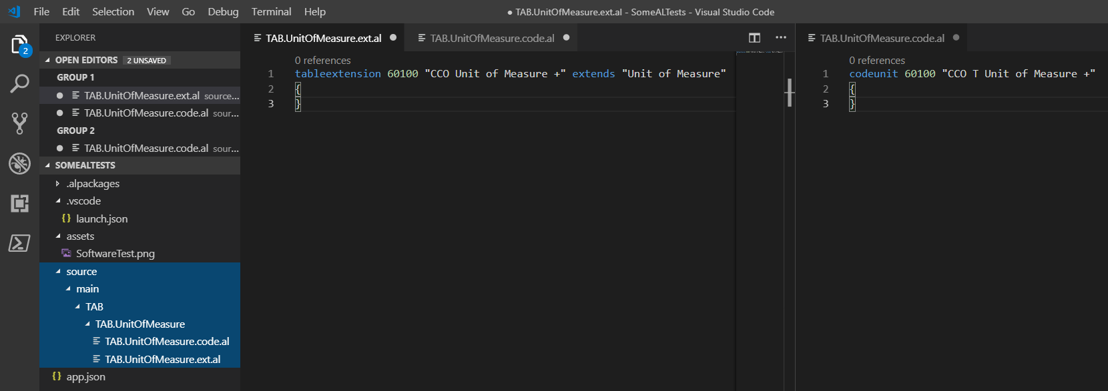
HandsOn
HandsOn – Exercise 13 | AL File Structure

Slide 51
HandsOn
HandsOn – Exercise 13 | Doing
Sequence of Execution of table extension field triggers compared to relevant standard triggers and events. Implement an Extension which is suited to show the order of execution of „OnBeforeValidate (Extension Trigger)“, „OnBeforeValidate (Table Field Event)“, „OnValidate (Table Field Trigger)“, „OnAfterValidate (Table Field Event)“ and „OnAfterValidate (Extension Trigger)“, use „Description“ field of „Unit of Measure“ as an example.
Implement a Message-Chain which is suited to show the order of execution.
Create new AL Project „SomeALTests“
Open VS Code,
press Alt+A Alt+L to create „Hello World“ …
Connect the Project to your DB
Adapt launch.json and app.json
Clean up „Hello World“ …
Implement Field Modification, add OnBefore-/OnAfterValidate Trigger, Implement Messages via suitable Calls to Object CU
Implement the Modification of the Standard
Add Message to the Validation of Description
Implement a MessageLaunch function within the Object CU
Create Extension of Tab 204 „Unit of Measure“
Create proper AL File Structure
Add Subscription of standard Validation Events to the Object CU,
call the MessageLauncher from wthin the subscriber
Implement Extension
Run the Project, gain insight …
Learn
how extension field trigger fit into the total field trigger / event scenario
that invoking intelliSense is always a good idea

Slide 52
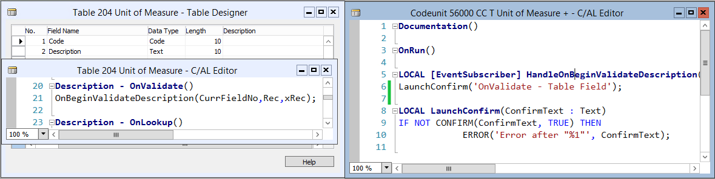
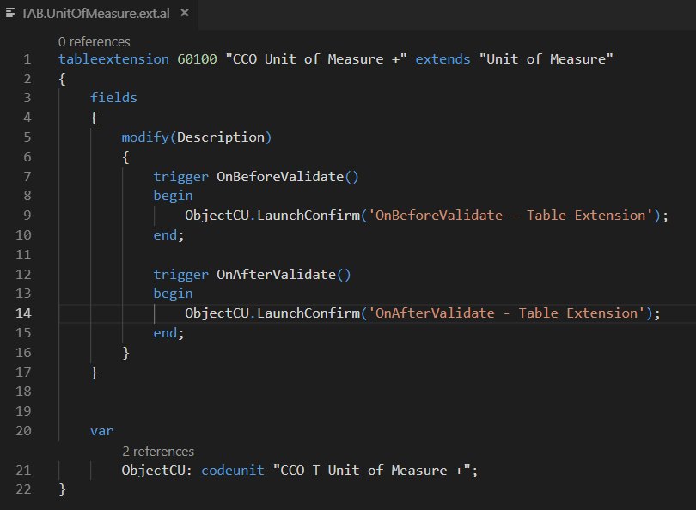
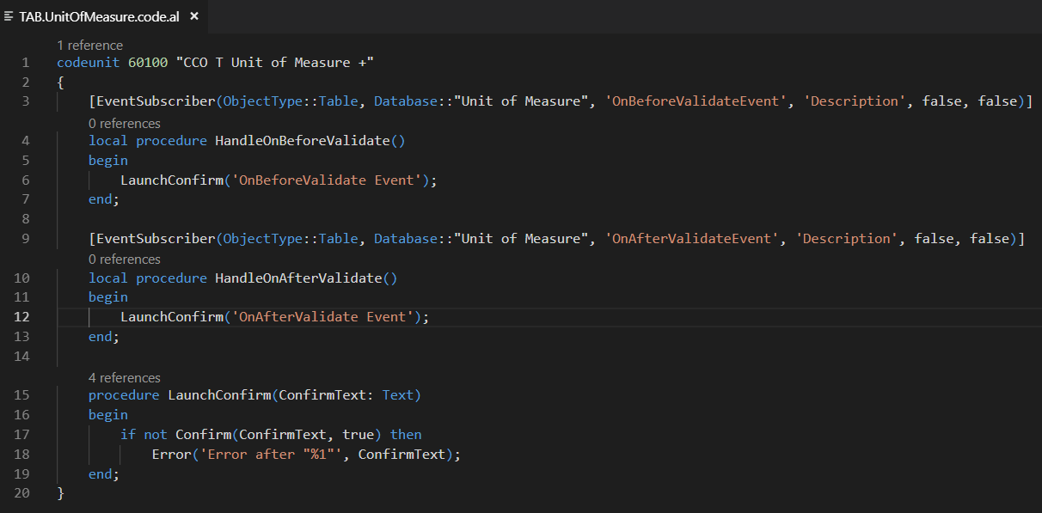
HandsOn
HandsOn – Exercise 13 | Hybrid Implementation
!!!

Slide 53
HandsOn
HandsOn – Exercise 14
Page Extension Layout

Slide 54
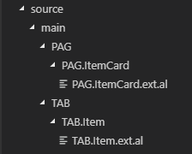
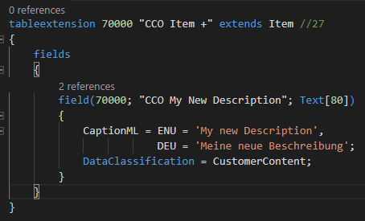
HandsOn
HandsOn – Exercise 14 | Page Extension Layout
Create an Item (Card) extension
Item Table: Add a new field „My new Description“ (Text 50)
Item Card
Add a label „Here comes the Item No.“ on first place of fast tab „Item“
Move the „Replenishment System“ from where ever it is at the right bottom of the „Item“ fast tab.
Add a „Description Group“ at the right bottom of the „Item“ fast tab, containing all three Item Descriptions
Rename „Item“ fast tab to „Item Fast Tab“ („Artikelregister“)
Add a new first fast tab „Descriptions“, place all three „Descriptions“ on this fast tab
Add an action to the „Sales“ section of the „Navigate“ menu which launches the currency list.
Open AL Project „SomeALTests“
There might be other ways of carrying out this implementation
Create proper file structure
Add field to „Item Extension“

Slide 55
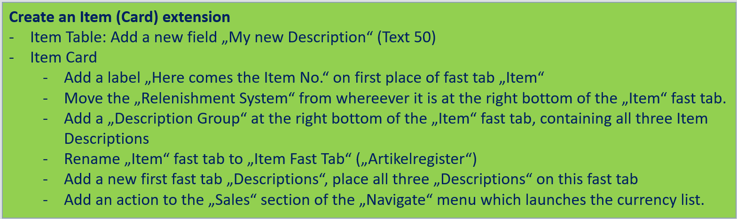
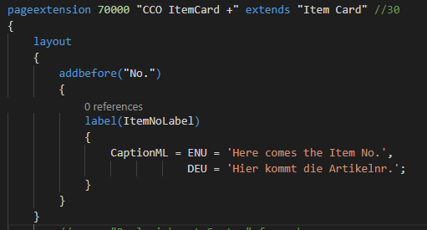
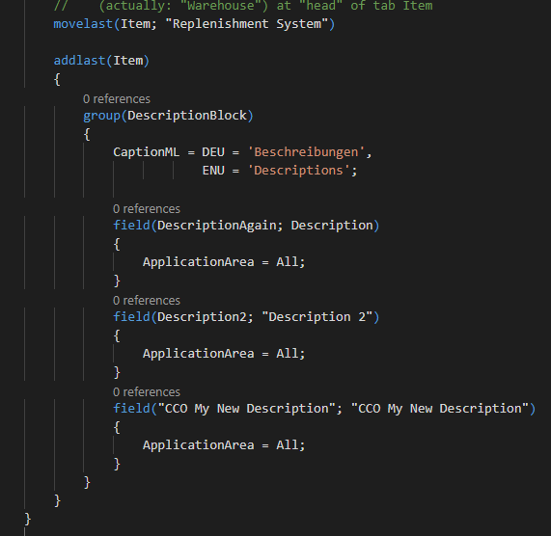
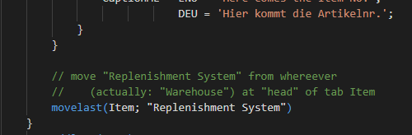
HandsOn – Exercise 14 | Page Extension Layout, continued 1
HandsOn
Add a label „Here comes the Item No.“ on first place of fast tab „Item“
Check Result
Move the „Relenishment System“ from where ever it is at the right bottom of the „Item“ fast tab.
There might be other ways of carrying out this implementation
Check Result
Add a „Description Group“ at the right bottom of the „Item“ fast tab, containing all three Item Descriptions

Slide 56
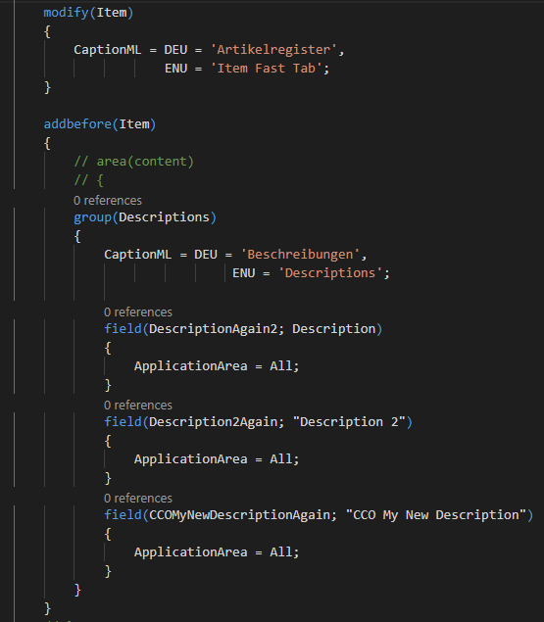
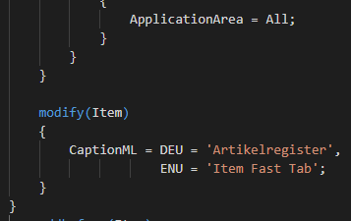
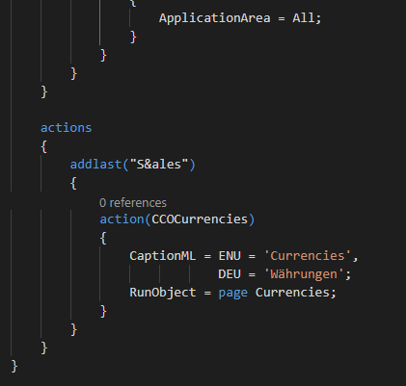
HandsOn – Exercise 14 | Page Extension Layout, continued 2
HandsOn
Rename „Item“ fast tab to „Item Fast Tab“ („Artikelregister“)
Check Result
Add a new first fast tab „Descriptions“, place all three „Descriptions“ on this fast tab
There might be other ways of carrying out this implementation
Check Result
Add an action to the „Sales“ section of the „Navigate“ menu which launches the currency list.

Slide 57
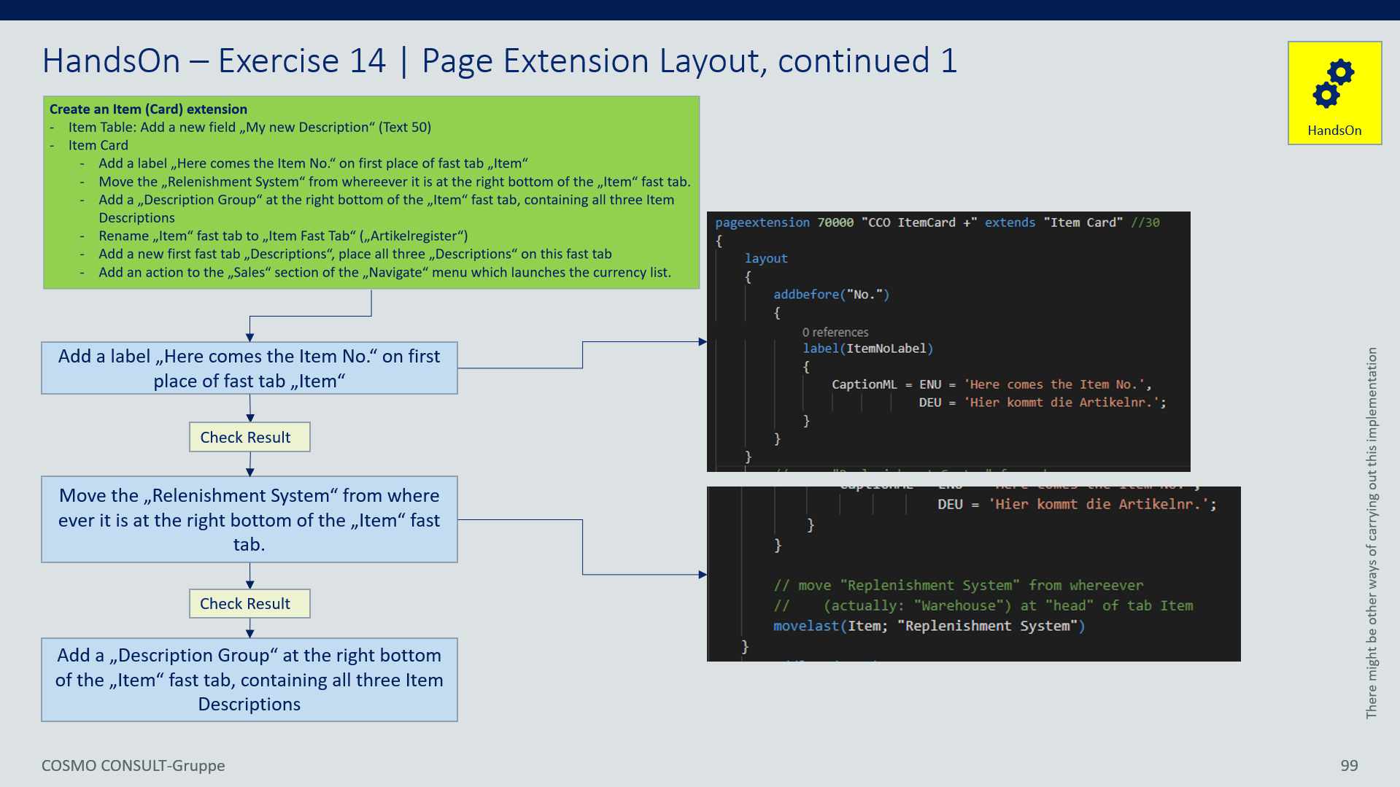
HandsOn – Exercise 14 | Page Extension Layout, continued 4
HandsOn
Learn
how to influence the layout of a page
Page extensions are „executed“ from top to bottom … „the last one wins“

Slide 58
HandsOn
HandsOn – Exercise 15
Module Hazard Category Part 2

Slide 59
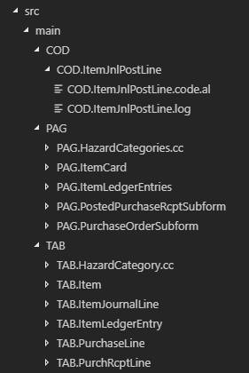
HandsOn
HandsOn – Exercise 15 | Module Hazard Category Part 2
FRD
It shall be possible to group Items according to their "Hazard Category". "Hazard Categories" should be freely definable. When an article is purchased via ordering, its "Hazard Category" is to be displayed in the purchasing document and should be changeable there. During the course of item posting, the "Hazard Category" has to be transferred into the "Item Ledger Entries" and, if indicated, into the posted purchase documents.
No other processes are to be respected.
No further details have to be respected concerning, e.g., manipulations of partially posted documents etc..
Remember: New data structure was setup with GAP-AL-004
GAP-AL-005: Hazard Categories – Functionality
Implement new fields in tables “Item”, “Purchase Line”, “Purch. Rcpt. Line”, “Item Journal Line” and “Item Ledger Entry”.
Implement functionality.
Open AL Project „Hazard Categories“
Don‘t forget the Documentation
Setup proper File Structure
Don‘t forget to update the „app.tags“
Implement GAP-AL-005
Run and Test the implementation

Slide 60
HandsOn
HandsOn – Exercise 15 | Module Hazard Category Part 2, continued
Functionality
Involved Objects
Data Structure & GUI
Posting:
Transfer of Hazard Category from Jnl Line to Entry
(via OnAfterInitItemLedgEntry)
New field „Hazard Category Code“ on Fast Tab „Item“
New field „Hazard Category Code“
Posting:
Transfer of „Hazard Category“ from Purchase Line to „Jnl Line“
(via OnAfterCopyItemJnlLineFromPurchLine)
New field „Hazard Category Code“ Code[20]
Preassignment & Consistecy Checks:
- Copy „Hazard Category“ from Item if not yet filled
(via OnAfterAssignItemValues)
- Ensure „Hazard Category“ only present with Items …

Slide 61
HandsOn
HandsOn – Exercise 16
Customer Classification, Enums

Slide 62
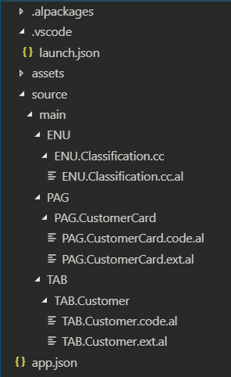
HandsOn
HandsOn – Exercise 16 | Customer Classification, Enums
GAP-AL-006: Customer Classification
It shall be possible to setup a classification of customers by assigning them one of the „values“ „---“, „Bronze Customer“, „Silver Customer“ or „Gold Customer“. An Action „Suggest Salutation“ in the Customer Action Group shall suggest a salutation depending on the particular classification. The Action starts a respective message „Hello <name>“, „Dear bronze <Name>“, „Dear silver <name>“ or „Dear most revered gold <name>“.
Create new AL Project „CustomerClassification“
Open VS Code,
press Alt+A Alt+L to create „Hello World“ …
Connect the Project to your DB
Adapt launch.json and app.json
Clean up „Hello World“ …
Implement the GAP
Create proper AL File Structure
There might be other ways of carrying out this implementation
Continuation

Slide 63
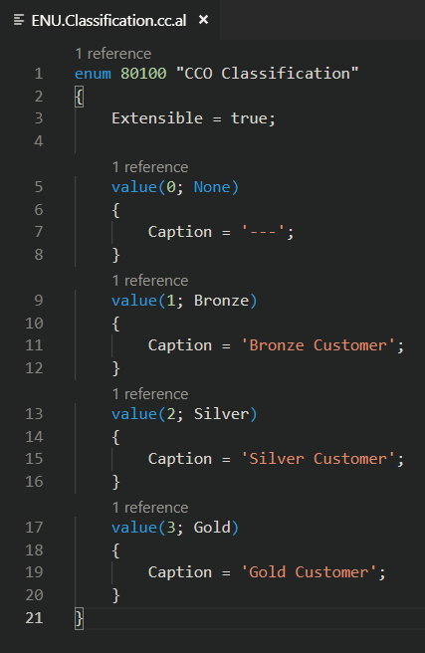
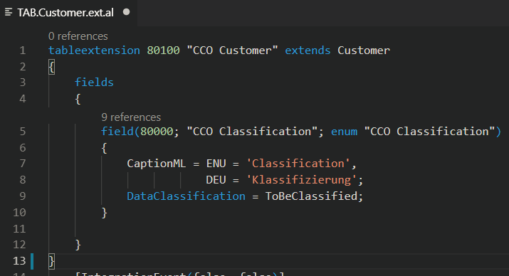
HandsOn
HandsOn – Exercise 16 | Customer Classification, Enums continued 1
GAP-AL-006: Customer Classification
It shall be possible to setup a classification of customers by assigning them one of the „values“ „---“, „Bronze Customer“, „Silver Customer“ or „Gold Customer“. An Action „Suggest Salutation“ in the Customer Action Group shall suggest a salutation depending on the particular classification. The Action starts a respective message „Hello <name>“, „Dear bronze <Name>“, „Dear silver <name>“ or „Dear most revered gold <name>“.
Implement the GAP
Create proper AL File Structure
Create Enum Object
Create Table Extension of Customer Table with new Classification Field
Show the field on Customer Card
There might be other ways of carrying out this implementation
Add Action functionality
Don‘t forget about Documentation
(logs and tags)
Run / Test the Project
Learn Enum Syntax

Slide 64
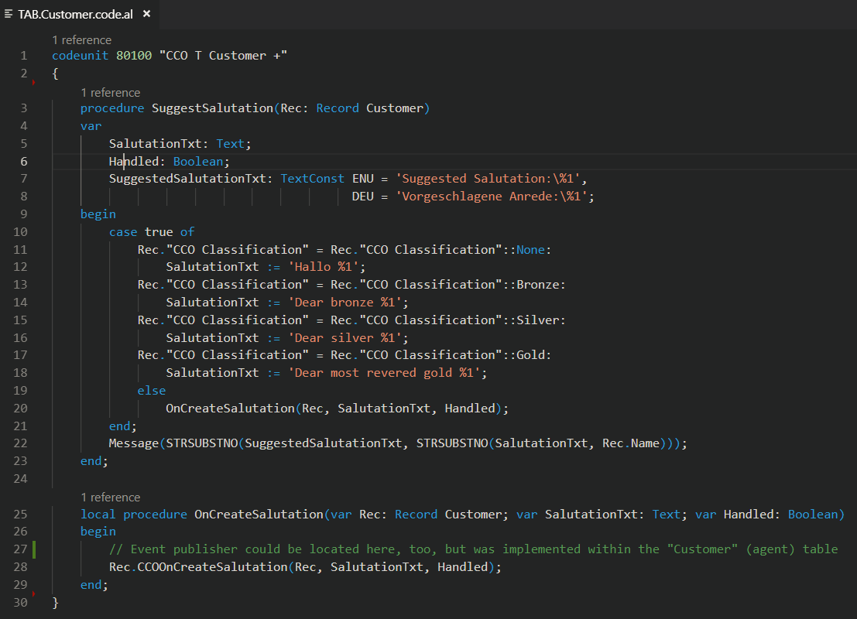
HandsOn
HandsOn – Exercise 16 | Customer Classification, Enums continued 2
GAP-AL-006: Customer Classification : Hints
There might be other ways of carrying out this implementation

Slide 65
HandsOn
HandsOn – Exercise 17
Extended Customer Classification, Enum Extensions
App Dependencies

Slide 66
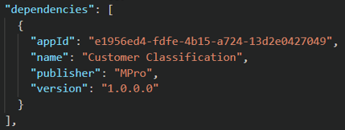
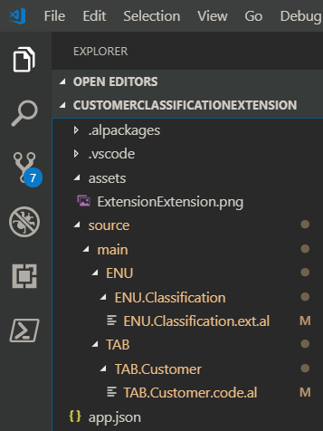
HandsOn
HandsOn – Exercise 17 | Extending Customer Classification, Extended Enums
GAP-AL-007: Extended Customer Classification
The Customer Classification system shall be extended by a new category „Platinum Customer“.
The corresponding salutation suggestion shall be „Hallo supreme most revered <name>“
Create new AL Project „CustomerClassificationExtension“
Open VS Code,
press Alt+A Alt+L to create „Hello World“ …
Connect the Project to your DB
Adapt launch.json and app.json
Clean up „Hello World“ …
Define the Dependency via app.json
There might be other ways of carrying out this implementation
Implement the GAP
Create proper AL File Structure
Continuation

Slide 67
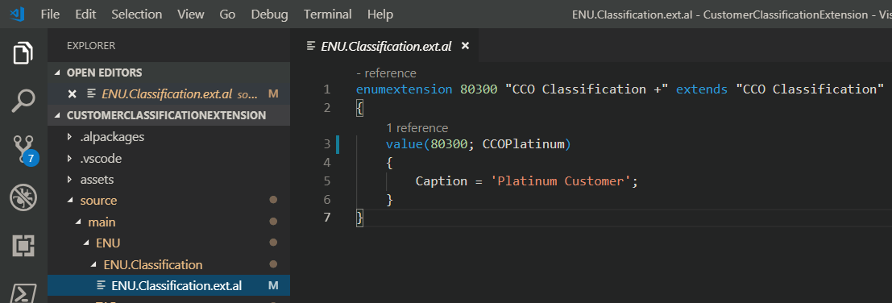
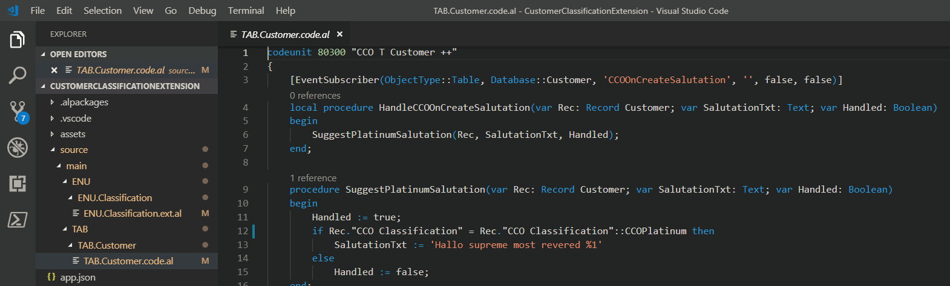
HandsOn
HandsOn – Exercise 17 | Extending Customer Classification, Extended Enums
GAP-AL-007: Extended Customer Classification
The Customer Classification system shall be extended by a new category „Platinum Customer“.
The corresponding salutation suggestion shall be „Hallo supreme most revered <name>“
Implement the GAP
Create proper AL File Structure
Implement Enum Extension
Implement Extension of Salutation Suggestion
There might be other ways of carrying out this implementation
Run / Test the Project

Slide 68
HandsOn
HandsOn – Exercise 18
CU Launcher

Slide 69
HandsOn
HandsOn – Exercise 18 | Tools: CU Launcher
GAP-AL-008: CU Launcher
A functionality is to be implemented, which allows to start particular codeunits via GUI.
Design
Page „CU Launcher“
with control „CU ID to launch“
Action „Launch CU“ which launches CU (after proper confirmation)
Create / Open AL Project „SomeALTests“
Open VS Code,
press Alt+A Alt+L to create „Hello World“ …
Connect the Project to your DB
Adapt launch.json and app.json
Clean up „Hello World“ …
There might be other ways of carrying out this implementation
Implement the GAP
Create proper AL File Structure
…
Run / Test the Project

